Slide 1
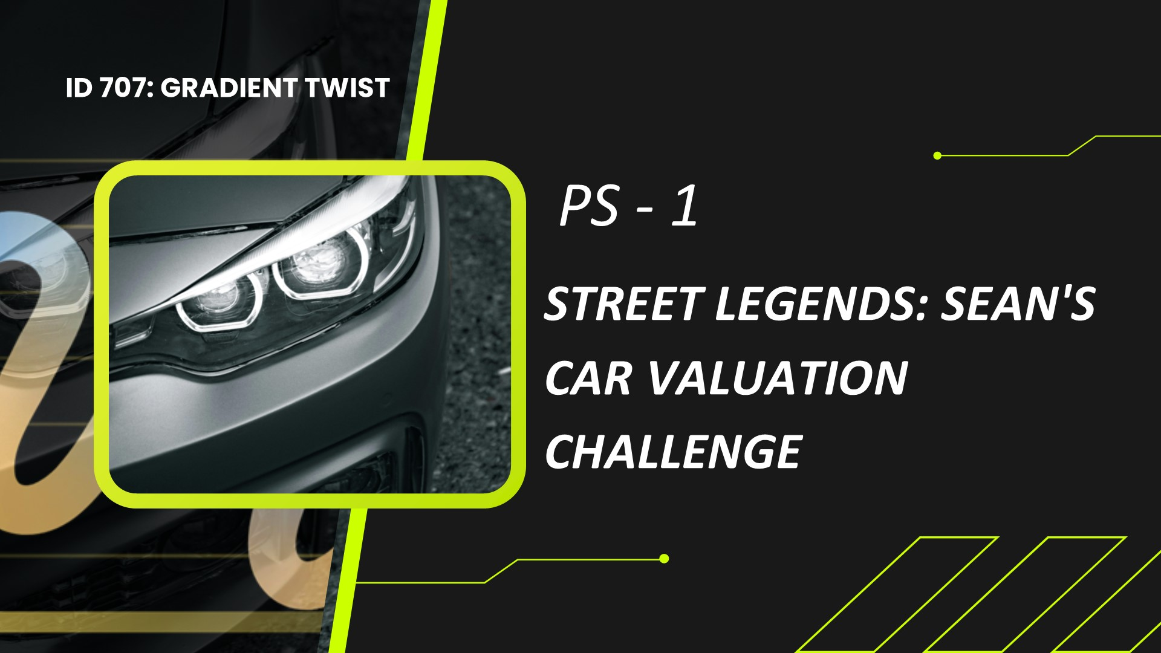

Slide 2


Slide 3
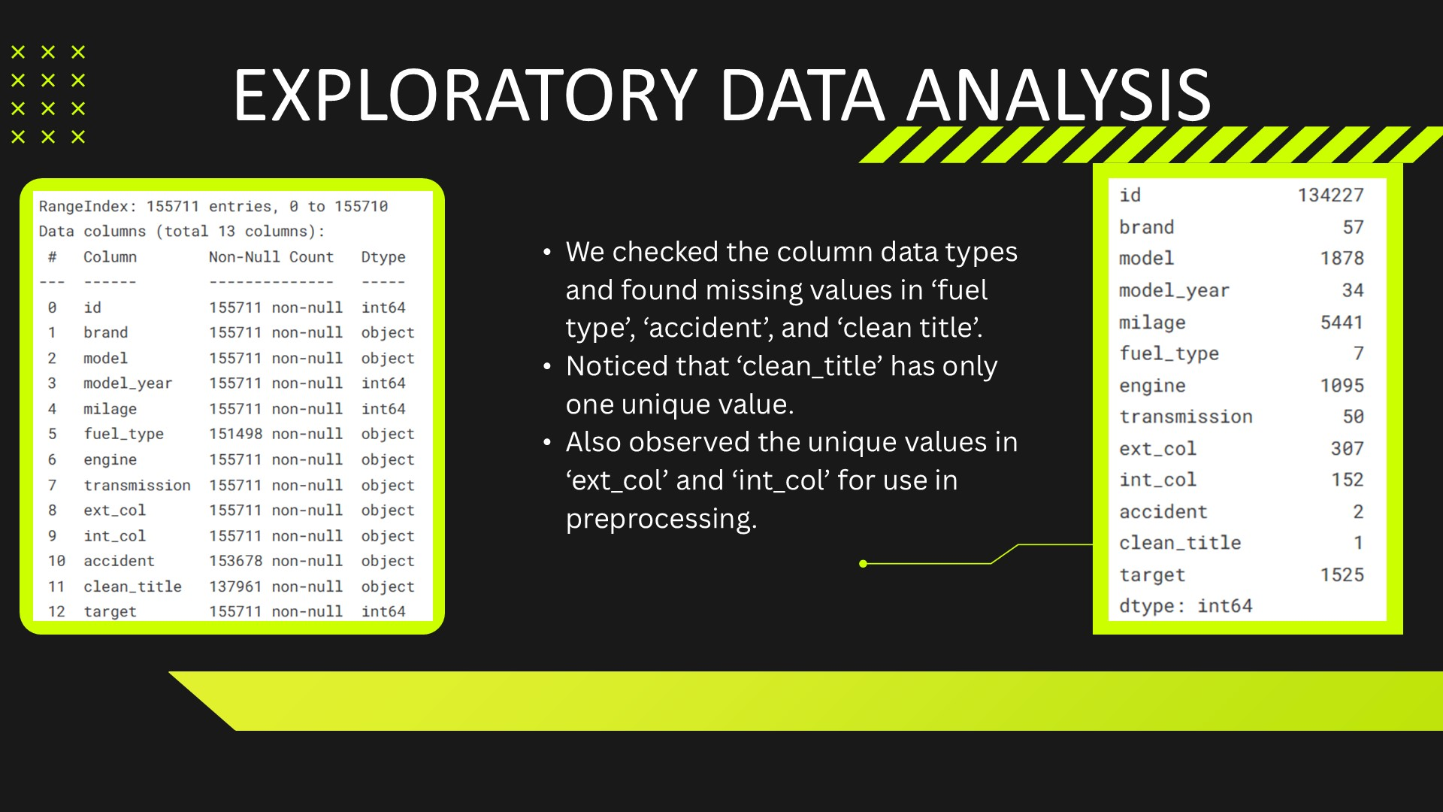

Slide 4
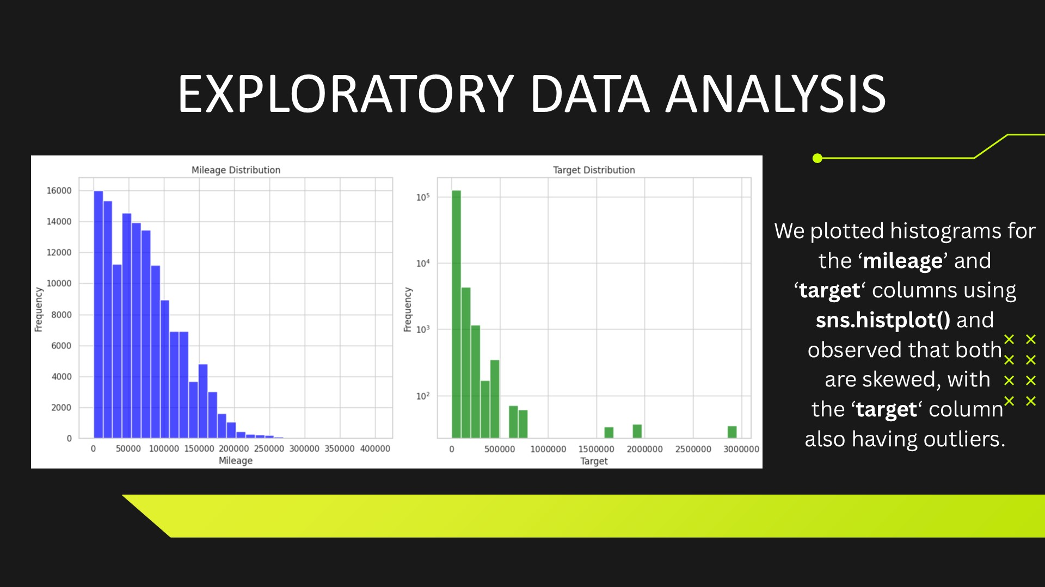

Slide 5
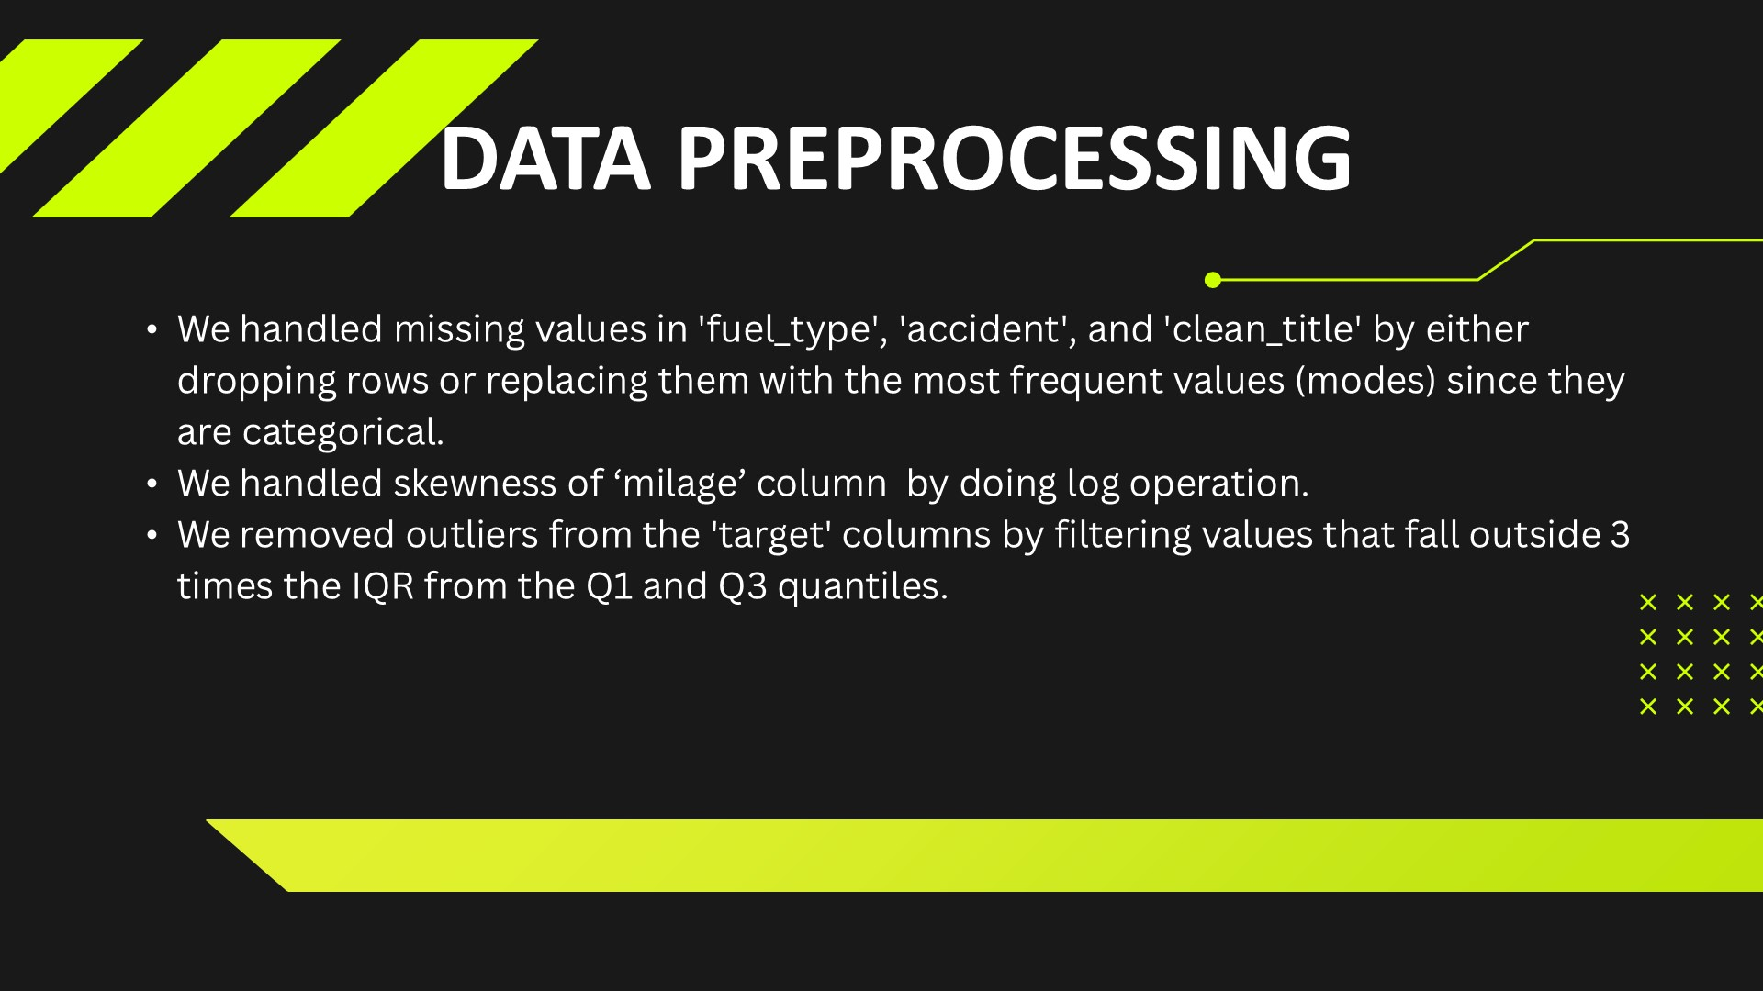

Slide 6
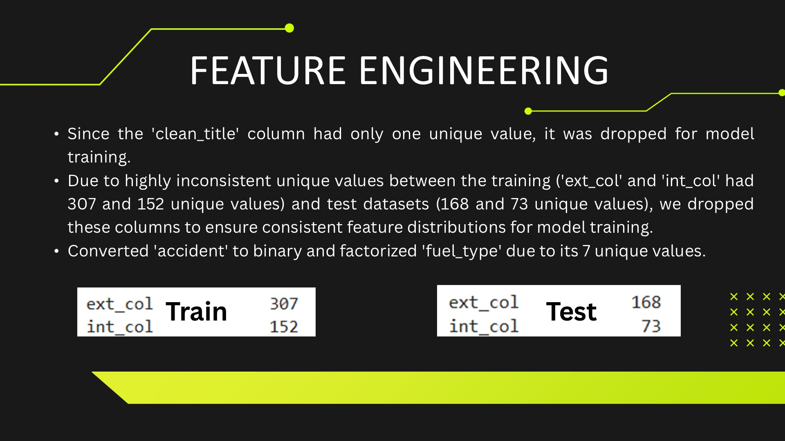

Slide 7
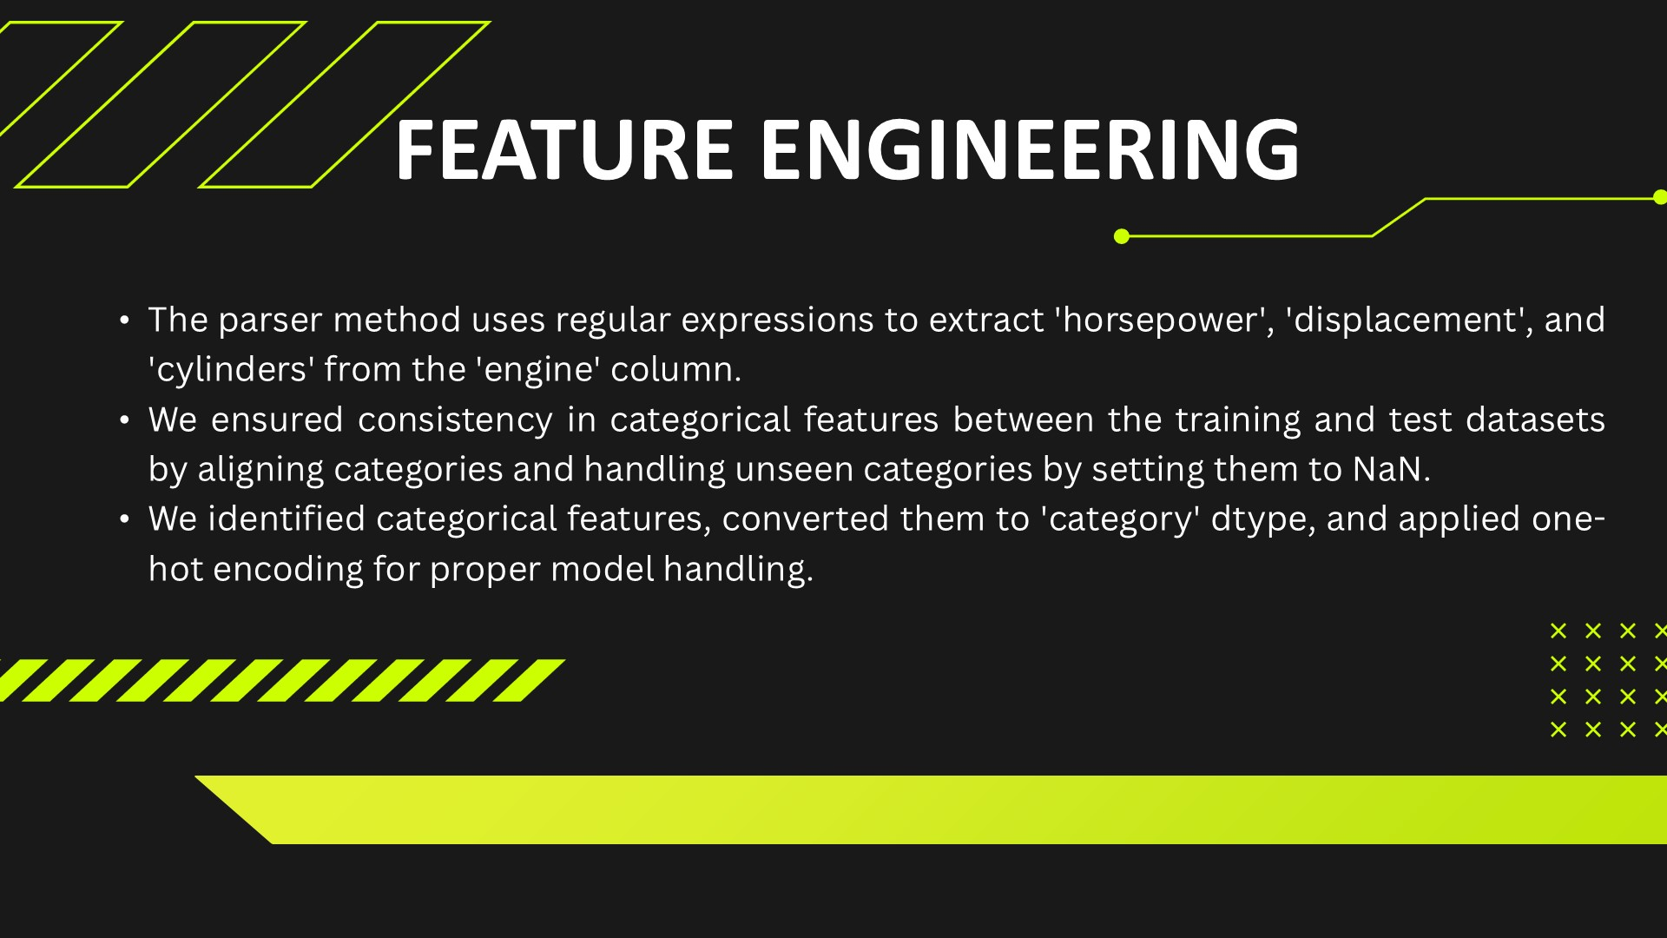

Slide 8
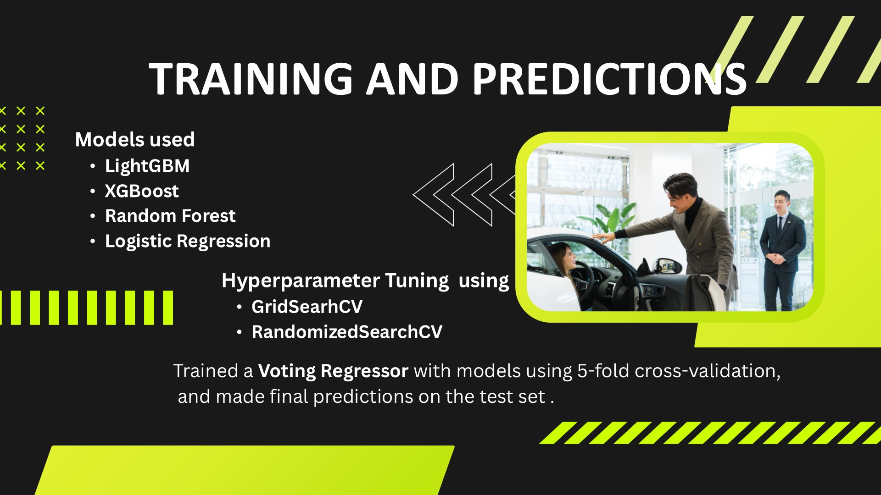

Slide 9
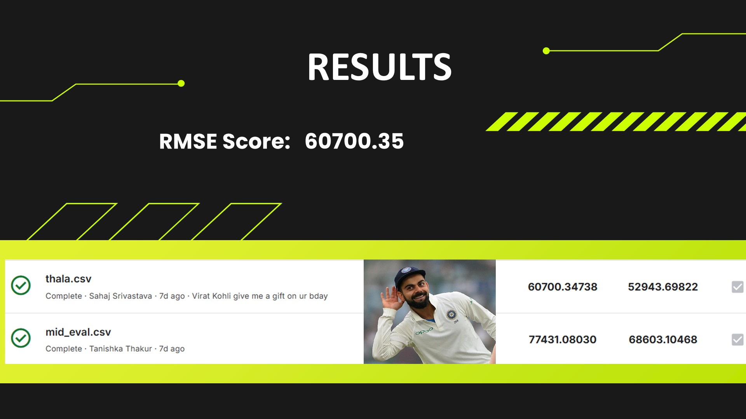

Slide 10




Slide 12
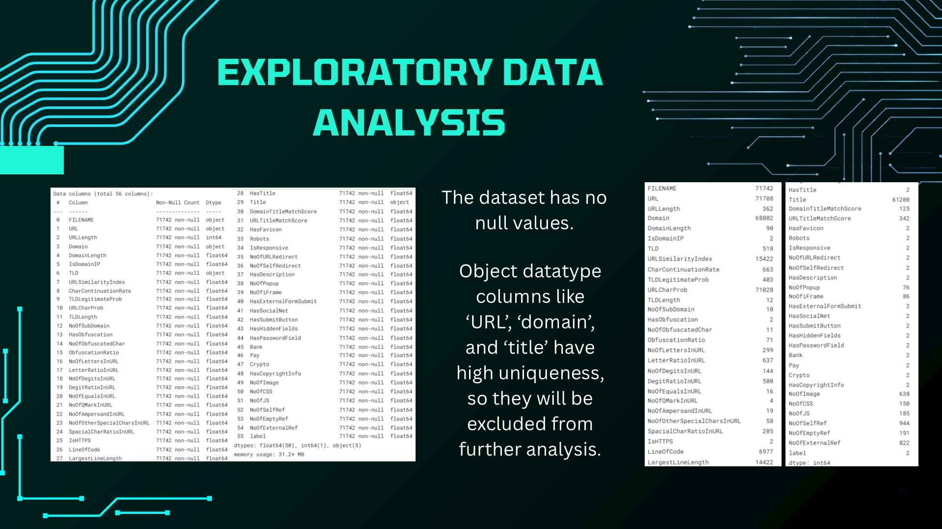

Slide 13
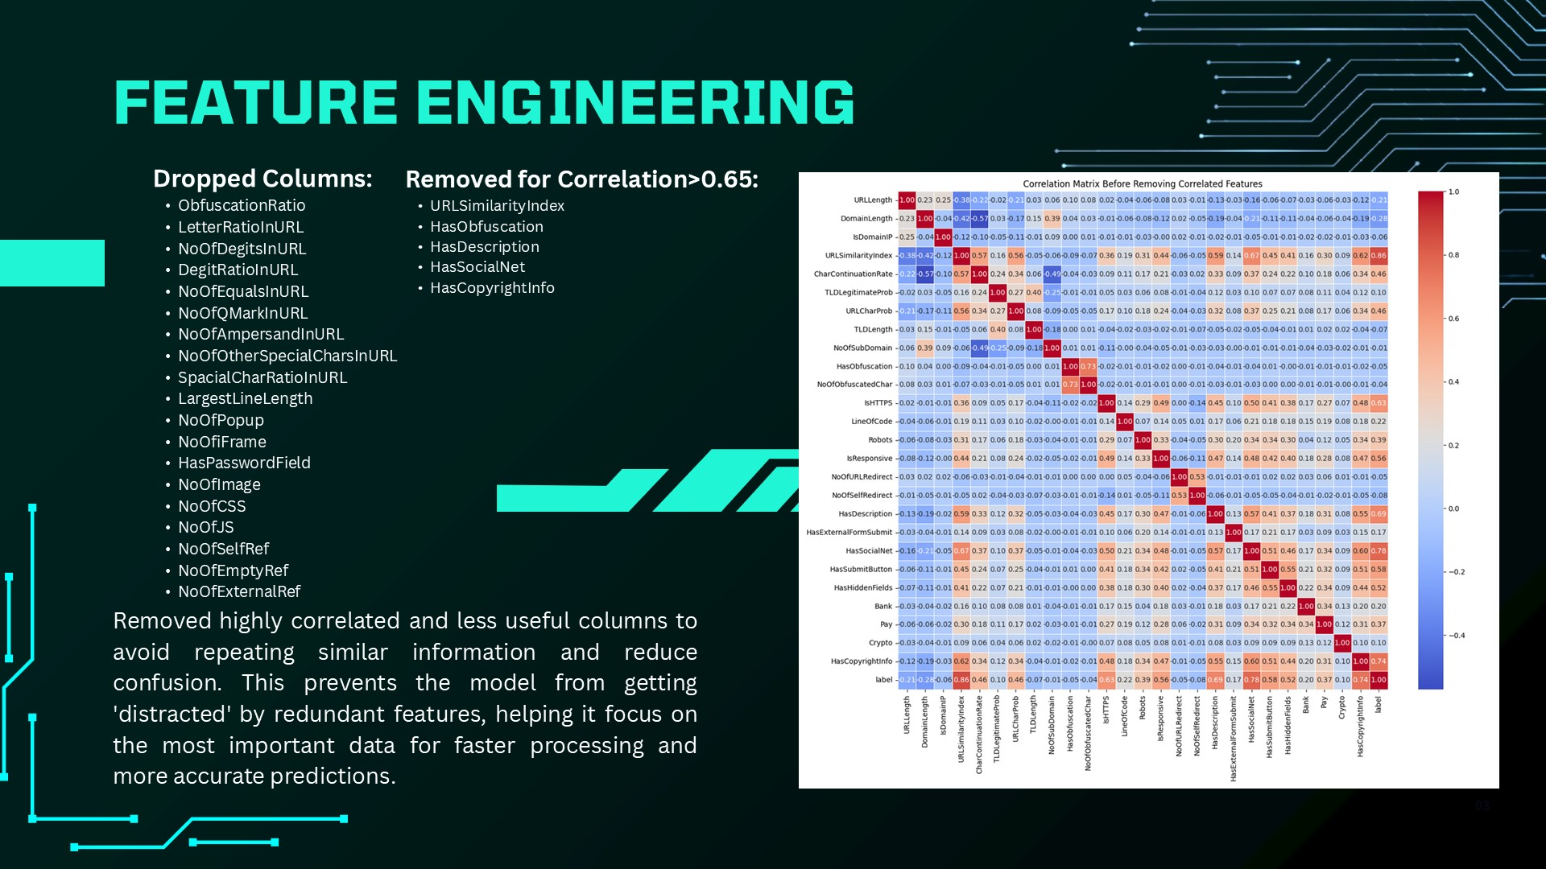

Slide 14
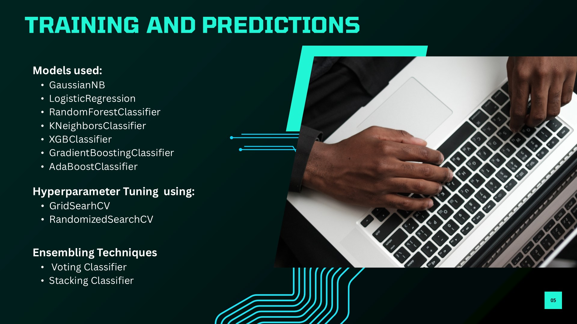

Slide 16
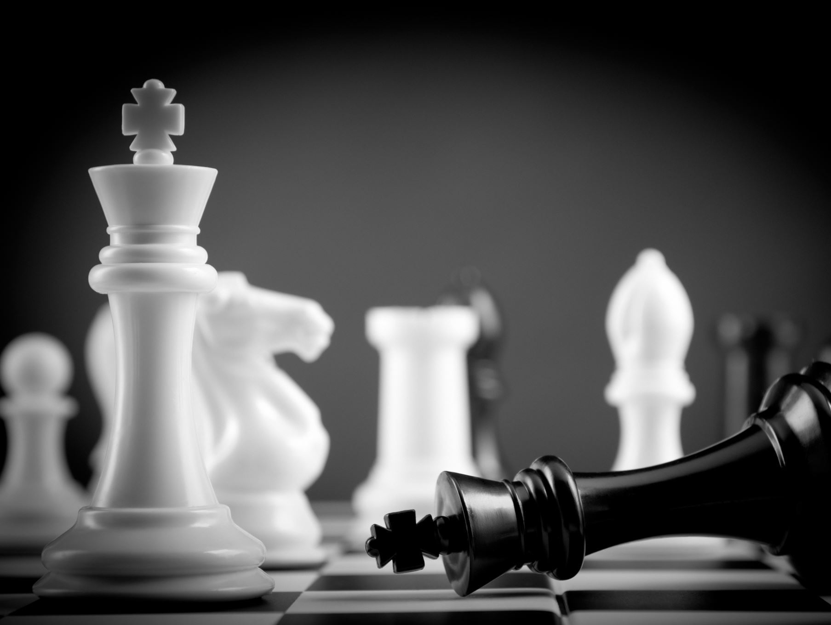

PS3 The Streets’ Chess Showdown: White vs Black

Slide 17

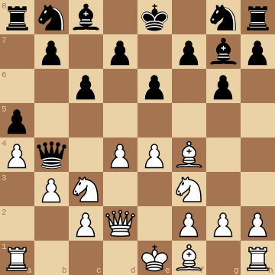
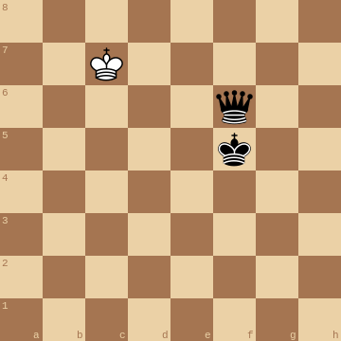
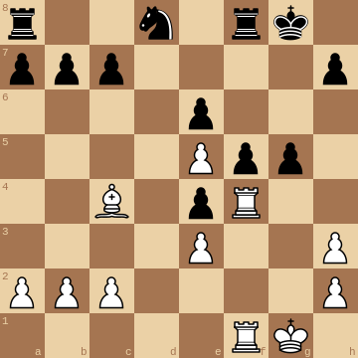
Peek Into Dataset

Slide 18
Yolo? CNN? What to use to identify positions where pieces are placed and classify each piece into type?

Slide 19
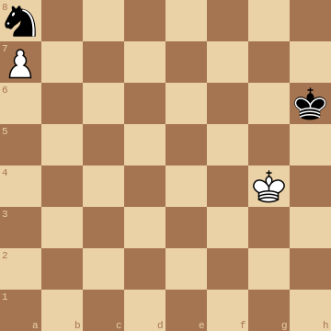

Kind of simple
CROP IT IN 45X45 SECTIONS TO GET THE INDIVIDUAL BOXES
<-- 360 px -->
<-- 45 px -->
<-- 45 px -->
<-- 360 px -->

Slide 20




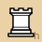

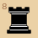







How to Classify
IMAGE SIMILARITY SCORE BASED CLASSIFICATION
(JUST 13 CLASSES TO COMPARE)
WHITE KING (W)

Slide 21
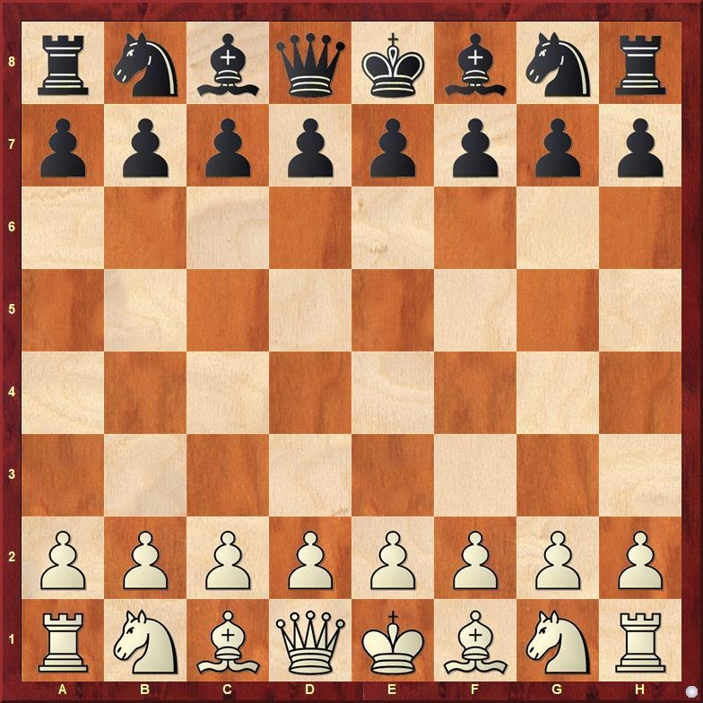

A BETTER REPRESENTATION FEN "INSPIRED" ENCODINGS
Stat for nerds: Forsyth-Edwards Notation
FEN
rnbqkbnr/pppppppp/8/8/8/8/PPPPPPPP/RNBQKBNR w KQkq - 0 1
Our Encoding
rnbqkbnr/pppppppp/8/8/8/8/PPPPPPPP/RNBQKBNR
Basically, didn't mention whose move it is, castling availability and a few other aspects of chess, just a positional representation

Slide 22
Note: For simplicity let's call that encoding as FEN encoding only
So, using a function that iterates over the chess board by cropping and classifying the chess pieces converts them into FEN strings
We made
train_fen_encoding.pkl
test_fen_encodings.pkl

Slide 23

CNN Based Approach

Slide 24
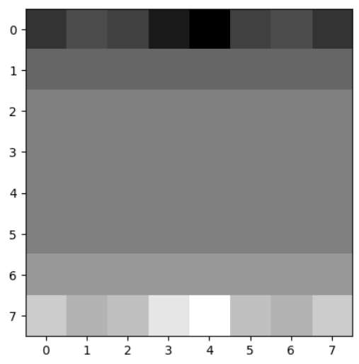
FEN To Grayscale Map

Slide 25
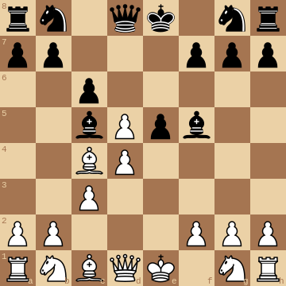

Inspiration
COMPLEX FEATURES
SIMPLER FEATURES​
We don't wish the CNN to identify features like the curves in the shape of the pieces rather want it to capture relation between the relative position and ultimate advantage class hence we simplified the FEN encodings into grayscale maps to feed to a CNN

Slide 26
CNN ARCHITECTURE
Input
(8x8x1)
Conv2D
(32)
(3x3)
(6x6x32)
MaxPool2D
(2x2)
(3x3x32)
Conv2D
(64)
(1x1)
(3x3x64)
MaxPool2D
(3x3x64)
Dropout
(0.25)
Flatten
(None, 576)
Dense (256)
(None,256)
Dense (3)
Softmax
(None,3)
Predicted
Probabilities
Using the Keras Sequential API (And Experimentation)

Slide 27





Why Use CNN?
We tried to treat this as a classification problem where filters over the image were used to look at a sized down region of the chess board and capture situations where a particular side appeared more disadvantaged and then (although not always) given the amount of data, it should learn some prediction ability

Slide 28
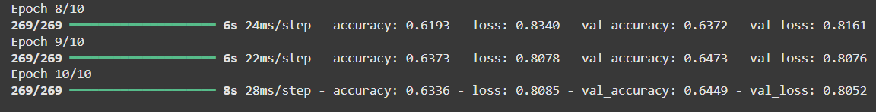
Outcome
Learning Rate: 0.005
Batch Size: 64
Epochs: 10
BEST ACCURACY ACHIEVED ON KAGGLE : 63.84%

Slide 29
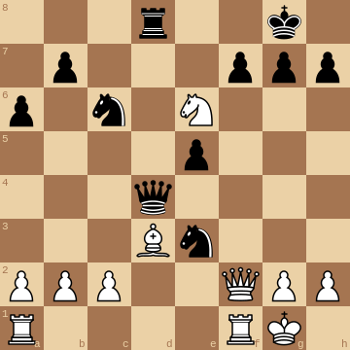




Anomalies?
In a game of chess, advantage of a player depends (broadly) upon two factors:
Advantage of relative position of chess pieces
Advantage of material strength
When we were trying to capture the essence of relative position advantage of chess pieces on board, we realized that since CNN is all about correlation of pixels with nearby pixels, we are not able to capture the big picture and assumption that if we apply 3x3 filters followed by 1x1 filters then it may help learn the grouped disadvantage was not that well conveyed across the dataset

Slide 30
Another Interesting Observation
Every time we trained CNN the correct white, black and equal changed drastically however the overall accuracy remained not that much affected

Slide 31
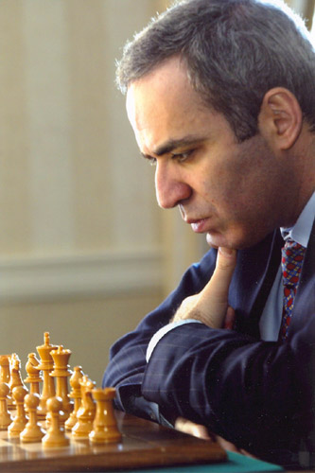
Material Strength Based Approach
Gary Kasparov

Slide 32

Intuition
Gary Kasparov once said, Материал обладает высокой прочностью which means material has great strength
Seeking Inspiration we developed a dataframe, with 12 columns each having the name of the pieces of chess (6 for each color)
Ran over the FEN encodings and for each board calculated the count of the chess pieces and added the row to the dataframe
Ran multiple machine learning models to classify the given data into one of three classes (white, black, equal)

Slide 33
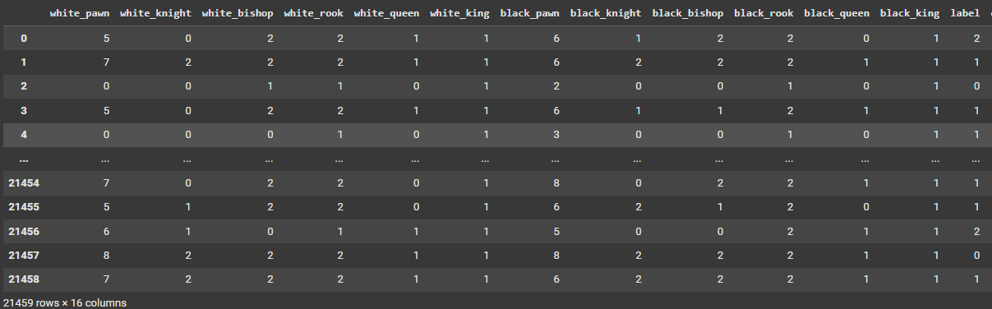
Glimpse of dataset generated

Slide 34
Models Tried
Additionally used GridSearchCV to tune hyperparameters
One hot encoding style column count expansion used to increase the number of features in dataset
LightGBM
SVM
Random Forest
Linear Regression
Catboost
XGBoost
Logistic Regression

Slide 35
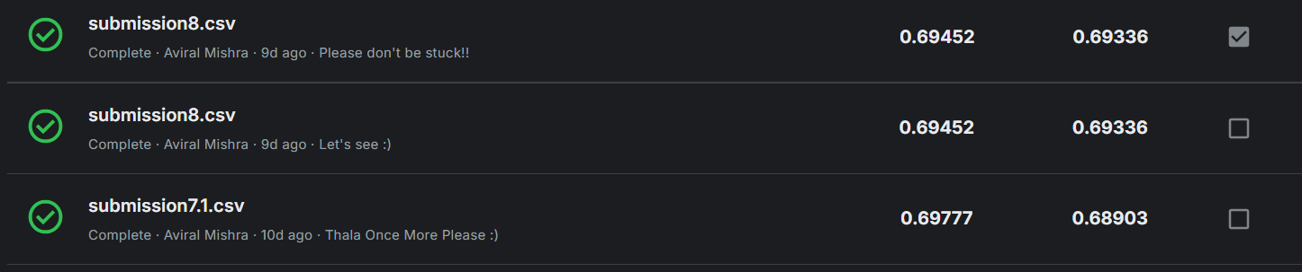
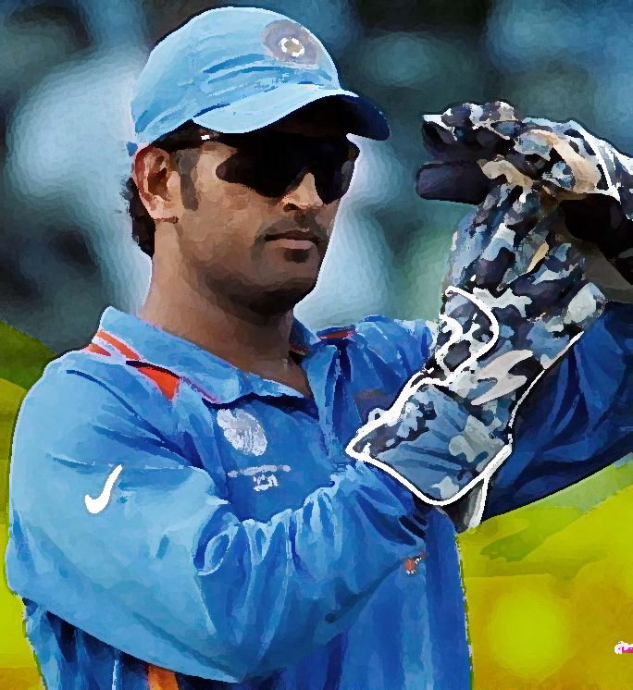
Outcome
Achieved a validation accuracy of 70.1% using lightgbm model with 12 features
Using this method only, we achieved our best Kaggle score of 69.45% (69.77% being overall best)

Slide 36
Some other ways we tried but it didn't work
Inception Module
Complex CNN Architectures
Using predicted probabilities of the CNN Model as features in the ML Based approach
Inception Module -> Overfitting
Complex CNN Architectures -> Overkill
Predicted Probabilities -> Didn't improve accuracy and nor did it decrease it much

Slide 37
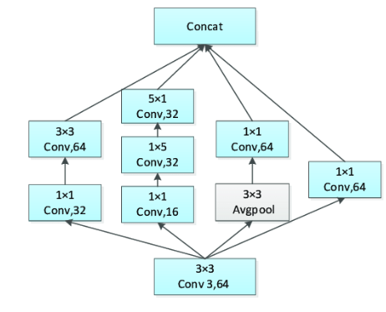
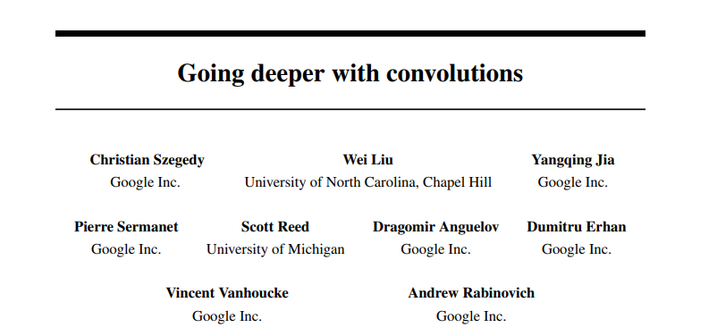
Inception Module

Slide 38
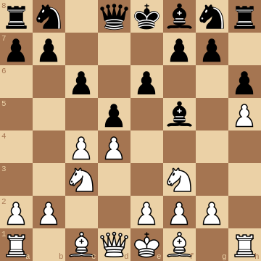
Work Ahead
Leveraging Positional Encodings generated by Vision Transformer to enhance the accuracy
Including other features into the dataset for ML based approach like: King Safety Score, Piece Mobility etc.

Slide 39


Thanks, and Regards Team Gradient Twist

